Slide 1
Lecture 1
Dynamic Nature of Relationships,
Serial Correlation

Slide 2
9.1
Introduction

Slide 3
9.1
Introduction
When modeling relationships between variables, the nature of the data that have been collected has an important bearing on the appropriate choice of an econometric model
Two features of time-series data to consider:
Time-series observations on a given economic unit, observed over a number of time periods, are likely to be correlated
Time-series data have a natural ordering according to time

Slide 4
9.1
Introduction
There is also the possible existence of dynamic relationships between variables
A dynamic relationship is one in which the change in a variable now has an impact on that same variable, or other variables, in one or more future time periods
These effects do not occur instantaneously but are spread, or distributed, over future time periods

Slide 5
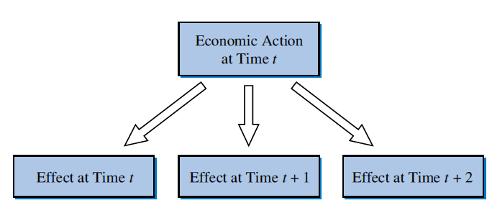
9.1
Introduction
FIGURE 9.1 The distributed lag effect

Slide 6

9.1
Introduction
9.1.1
Dynamic Nature of Relationships
Ways to model the dynamic relationship:
Specify that a dependent variable y is a function of current and past values of an explanatory variable x
Because of the existence of these lagged effects, Eq. 9.1 is called a distributed lag model
Eq. 9.1
$$y_{t}=f(x_{t},x_{t−1},x_{t−2},...)$$

Slide 7


9.1
Introduction
9.1.1
Dynamic Nature of Relationships
Ways to model the dynamic relationship (Continued):
Capturing the dynamic characteristics of time-series by specifying a model with a lagged dependent variable as one of the explanatory variables
Or have:
Such models are called autoregressive distributed lag (ARDL) models, with ‘‘autoregressive’’ meaning a regression of y_{t} on its own lag or lags
Eq. 9.2
$$y_{t}=f(y_{t−1},x_{t})$$
Eq. 9.3
$$y_{t}=f(y_{t−1},x_{t},x_{t−1},x_{t−2})$$

Slide 8

9.1
Introduction
9.1.1
Dynamic Nature of Relationships
Ways to model the dynamic relationship (Continued):
Model the continuing impact of change over several periods via the error term
In this case e_{t} is correlated with e_{t - 1}
We say the errors are serially correlated or autocorrelated
Eq. 9.4
$$y_{t}=f(x_{t})+e_{t} e_{t}=f(e_{t−1})$$

Slide 9

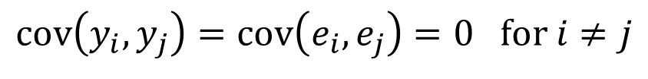
9.1
Introduction
9.1.2
Least Squares Assumptions
The primary assumption is Assumption MR4:
For time series, this is written as:
The dynamic models in Eqs. 9.2, 9.3 and 9.4 imply correlation between y_{t} and y_{t - 1} or e_{t} and e_{t - 1} or both, so they clearly violate assumption MR4
$$\operatorname{cov}\left(y_{i},y_{j}\right)=\operatorname{cov}\left(e_{i},e_{j}\right)=0 \text{for} i≠j$$
$$\operatorname{cov}\left(y_{t},y_{s}\right)=\operatorname{cov}\left(e_{t},e_{s}\right)=0 \text{for} t≠s$$

Slide 10
9.1
Introduction
9.1.2a
Stationarity
A stationary variable is one that is not explosive, nor trending, and nor wandering aimlessly without returning to its mean

Slide 11
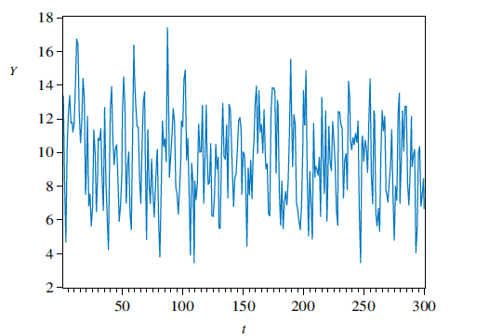
9.1
Introduction
FIGURE 9.2 (a) Time series of a stationary variable
9.1.2a
Stationarity

Slide 12
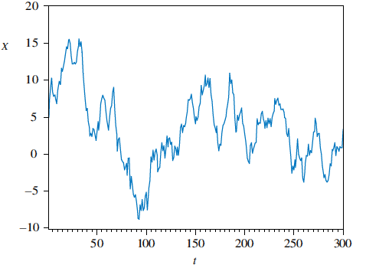
9.1
Introduction
FIGURE 9.2 (b) time series of a nonstationary variable that is ‘‘slow-turning’’ or ‘‘wandering’’
9.1.2a
Stationarity

Slide 13
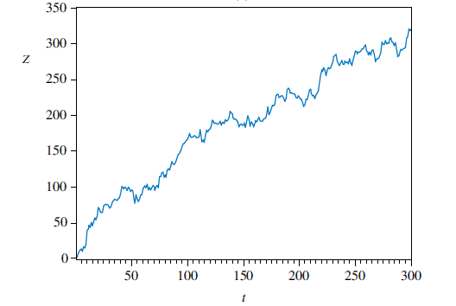
9.1
Introduction
FIGURE 9.2 (c) time series of a nonstationary variable that ‘‘trends”
9.1.2a
Stationarity

Slide 14
9.2
Finite Distributed Lags

Slide 15
9.2
Finite Distributed Lags
Consider a linear model in which, after q time periods, changes in x no longer have an impact on y
Note the notation change: β_{s} is used to denote the coefficient of x_{t-s} and α is introduced to denote the intercept
Eq. 9.5
$$y_{t}=α+β_{0}x_{t}+β_{1}x_{t−1}+β_{2}x_{t−2}+⋯+β_{q}x_{t−q}+e_{t}$$

Slide 16
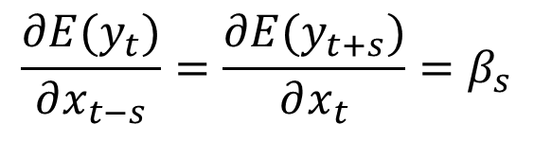
9.2
Finite Distributed Lags
Model 9.5 has two uses:
Forecasting
Policy analysis
What is the effect of a change in x on y?
Eq. 9.6
$$y_{T+1}=α+β_{0}x_{T+1}+β_{1}x_{T}+β_{2}x_{T−1}+⋯+β_{q}x_{T−q+1}+e_{T+1}$$
$$\frac{∂E(y_{t})}{∂x_{t−s}}=\frac{∂E(y_{t+s})}{∂x_{t}}=β_{s}$$
Eq. 9.7

Slide 17

9.2
Finite Distributed Lags
Assume x_{t} is increased by one unit and then maintained at its new level in subsequent periods
The immediate impact will be β₀
the total effect in period t + 1 will be β₀ + β₁, in period t + 2 it will be β₀ + β₁ + β₂, and so on
These quantities are called interim multipliers
The total multiplier is the final effect on y of the sustained increase after q or more periods have elapsed
$$\sum_{s=0}^{q}{β_{s}}$$

Slide 18
9.2
Finite Distributed Lags
The effect of a one-unit change in x_{t} is distributed over the current and next q periods, from which we get the term ‘‘distributed lag model’’
It is called a finite distributed lag model of order q
It is assumed that after a finite number of periods q, changes in x no longer have an impact on y
The coefficient β_{s} is called a distributed-lag weight or an s-period delay multiplier
The coefficient β₀ (s = 0) is called the impact multiplier

Slide 19
9.2
Finite Distributed Lags
ASSUMPTIONS OF THE DISTRIBUTED LAG MODEL
9.2.1
Assumptions
TSMR1.
TSMR2. y and x are stationary random variables, and e_{t} is independent of
current, past and future values of x.
TSMR3. E(e_{t}) = 0
TSMR4. var(e_{t}) = σ²
TSMR5. cov(e_{t}, e_{s}) = 0 t ≠ s
TSMR6. e_{t} ~ N(0, σ²)
$$y_{t}=α+β_{0}x_{t}+β_{1}x_{t−1}+β_{2}x_{t−2}+⋯+β_{q}x_{t−q}+e_{t}, t=q+1,…,T$$

Slide 20

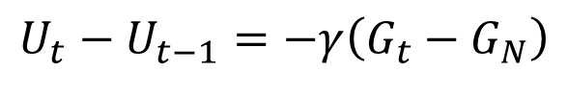
9.2
Finite Distributed Lags
9.2.2
An Example: Okun’s Law
Consider Okun’s Law
In this model the change in the unemployment rate from one period to the next depends on the rate of growth of output in the economy:
We can rewrite this as:
where DU = ΔU = U_{t} - U_{t-1}, β₀ = -γ, and α = γG_{N}
Eq. 9.8
$$U_{t}−U_{t−1}=−γ\left(G_{t}−G_{N}\right)$$
Eq. 9.9
$$DU_{t}=α+β_{0}G_{t}+e_{t}$$

Slide 21
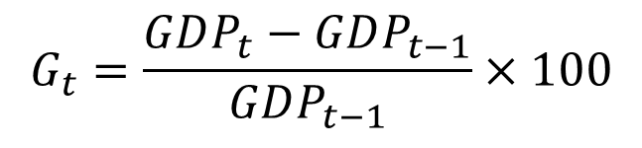
9.2
Finite Distributed Lags
9.2.2
An Example: Okun’s Law
We can expand this to include lags:
We can calculate the growth in output, G, as:
Eq. 9.10
$$DU_{t}=α+β_{0}G_{t}+β_{1}G_{t−1}+β_{2}G_{t−2}+⋯+β_{q}G_{t−q}+e_{t}$$
$$G_{t}=\frac{GDP_{t}−GDP_{t−1}}{GDP_{t−1}}×100$$
Eq. 9.11

Slide 22
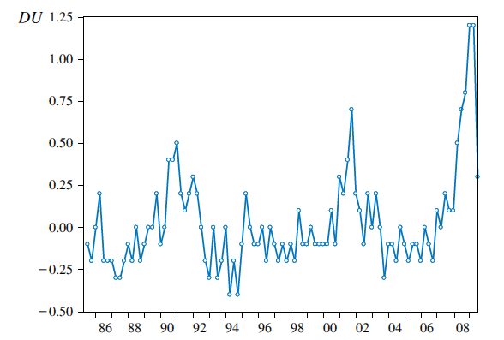
9.2
Finite Distributed Lags
FIGURE 9.4 (a) Time series for the change in the U.S. unemployment rate: 1985Q3 to 2009Q3
9.2.2
An Example: Okun’s Law

Slide 23
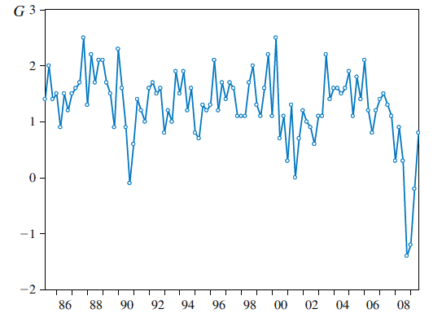
9.2
Finite Distributed Lags
FIGURE 9.4 (b) Time series for U.S. GDP growth: 1985Q2 to 2009Q3
9.2.2
An Example: Okun’s Law

Slide 24
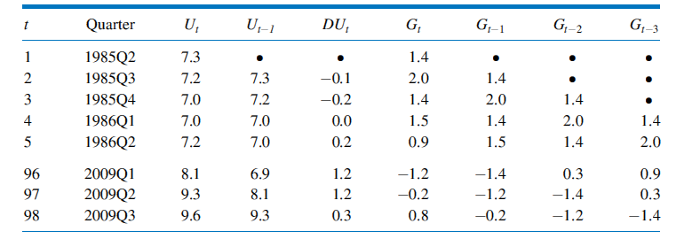
9.2
Finite Distributed Lags
Table 9.1 Spreadsheet of Observations for Distributed Lag Model
9.2.2
An Example: Okun’s Law

Slide 25
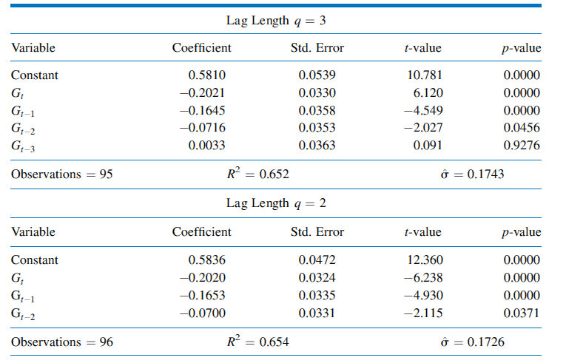
9.2
Finite Distributed Lags
Table 9.2 Estimates for Okun’s Law Finite Distributed Lag Model
9.2.2
An Example: Okun’s Law

Slide 26
9.3
Serial Correlation

Slide 27
9.3
Serial Correlation
When is assumption TSMR5, cov(e_{t}, e_{s}) = 0 for t ≠ s likely to be violated, and how do we assess its validity?
When a variable exhibits correlation over time, we say it is autocorrelated or serially correlated
These terms are used interchangeably

Slide 28
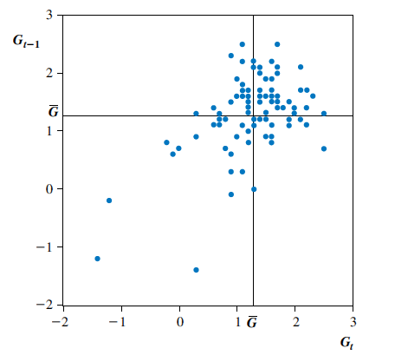
9.3
Serial Correlation
FIGURE 9.5 Scatter diagram for G_{t} and G_{t-1}
9.3.1
Serial Correlation in Output Growth

Slide 29

9.3
Serial Correlation
9.3.1a
Computing Autocorrelation
Recall that the population correlation between two variables x and y is given by:
$$ρ_{xy}=\frac{\operatorname{cov}\left(x,y\right)}{\sqrt{\operatorname{var}\left(x\right)\operatorname{var}\left(y\right)}}$$

Slide 30
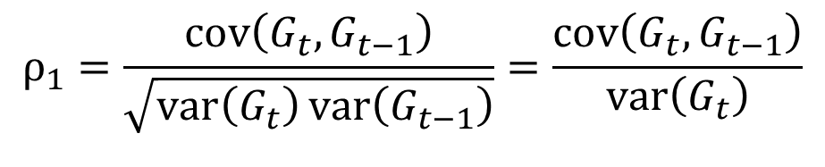
9.3
Serial Correlation
9.3.1a
Computing Autocorrelation
For the Okun’s Law problem, we have:
The notation ρ₁ is used to denote the population correlation between observations that are one period apart in time
This is known also as the population autocorrelation of order one.
The second equality in Eq. 9.12 holds because var(G_{t}) = var(G_{t-1}) , a property of time series that are stationary
$$ρ_{1}=\frac{\operatorname{cov}\left(G_{t},G_{t−1}\right)}{\sqrt{\operatorname{var}\left(G_{t}\right)\operatorname{var}\left(G_{t−1}\right)}}=\frac{\operatorname{cov}\left(G_{t},G_{t−1}\right)}{\operatorname{var}\left(G_{t}\right)}$$
Eq. 9.12

Slide 31
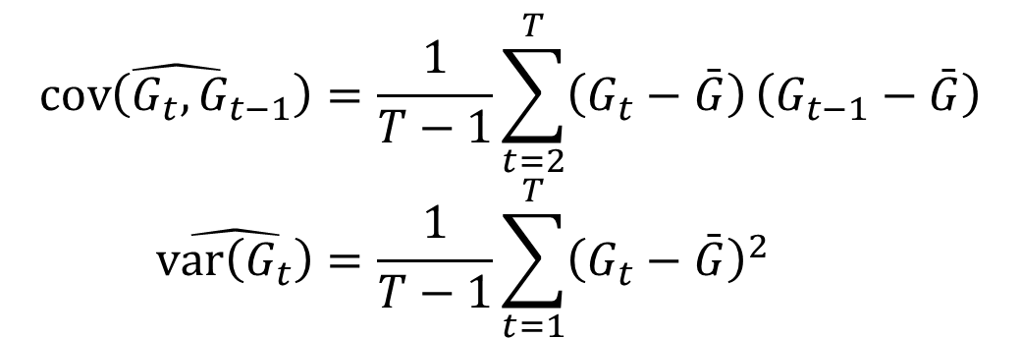
9.3
Serial Correlation
9.3.1a
Computing Autocorrelation
The first-order sample autocorrelation for G is obtained from Eq. 9.12 using the estimates:
$$\hat{\operatorname{cov}\left(G_{t},G_{t−1}\right)}=\frac{1}{T−1}\sum_{t=2}^{T}{\left(G_{t}−\bar{G}\right)}\left(G_{t−1}−\bar{G}\right) \\ \hat{\operatorname{var}\left(G_{t}\right)}=\frac{1}{T−1}\sum_{t=1}^{T}{{\left(G_{t}−\bar{G}\right)}^{2}}$$

Slide 32

9.3
Serial Correlation
9.3.1a
Computing Autocorrelation
Making the substitutions, we get:
$$r_{1}=\frac{\sum_{t=2}^{T}{\left(G_{t}−\bar{G}\right)}\left(G_{t−1}−\bar{G}\right)}{\sum_{t=1}^{T}{{\left(G_{t}−\bar{G}\right)}^{2}}}$$
Eq. 9.13

Slide 33

9.3
Serial Correlation
9.3.1a
Computing Autocorrelation
More generally, the k-th order sample autocorrelation for a series y that gives the correlation between observations that are k periods apart is:
Eq. 9.14
$$r_{k}=\frac{\sum_{t=k+1}^{T}{\left(y_{t}−\bar{y}\right)}\left(y_{t−k}−\bar{y}\right)}{\sum_{t=1}^{T}{{\left(y_{t}−\bar{y}\right)}^{2}}}$$

Slide 34
9.3
Serial Correlation
9.3.1a
Computing Autocorrelation
Applying this to our problem, we get for the first four autocorrelations:
Eq. 9.16
$$r_{1}=0.494 r_{2}=0.411 r_{3}=0.154 r_{4}=0.200$$

Slide 35
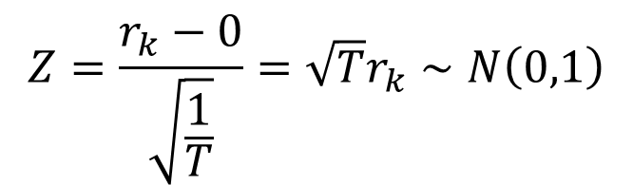
9.3
Serial Correlation
9.3.1a
Computing Autocorrelation
How do we test whether an autocorrelation is significantly different from zero?
The null hypothesis is H₀: ρ_{k} = 0
A suitable test statistic is:
$$Z=\frac{r_{k}−0}{\sqrt{\frac{1}{T}}}=\sqrt{T}r_{k}∼N\left(0,1\right)$$
Eq. 9.17

Slide 36
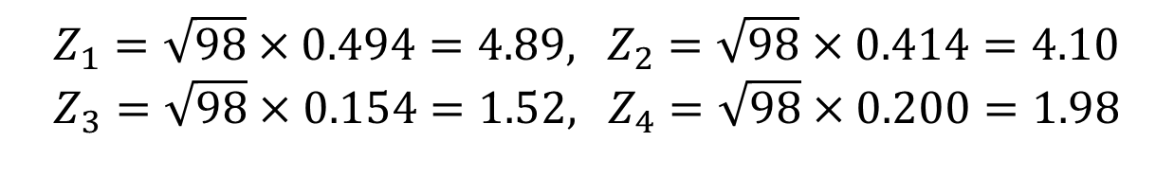
9.3
Serial Correlation
9.3.1a
Computing Autocorrelation
For our problem, we have:
We reject the hypotheses H₀: ρ₁ = 0 and H₀: ρ₂ = 0
We have insufficient evidence to reject H₀: ρ₃ = 0
ρ₄ is on the borderline of being significant.
We conclude that G, the quarterly growth rate in U.S. GDP, exhibits significant serial correlation at lags one and two
$$Z_{1}=\sqrt{98}×0.494=4.89\text{,} Z_{2}=\sqrt{98}×0.414=4.10 \\ Z_{3}=\sqrt{98}×0.154=1.52\text{,} Z_{4}=\sqrt{98}×0.200=1.98$$

Slide 37
9.3
Serial Correlation
9.3.1b
The Correlagram
The correlogram, also called the sample autocorrelation function, is the sequence of autocorrelations r₁, r₂, r₃, …
It shows the correlation between observations that are one period apart, two periods apart, three periods apart, and so on

Slide 38
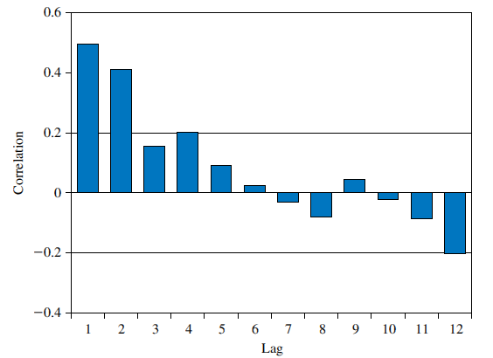
9.3
Serial Correlation
FIGURE 9.6 Correlogram for G
9.3.1b
The Correlagram

Slide 39
9.3
Serial Correlation
9.3.2
Serially Correlated Errors
The correlogram can also be used to check whether the multiple regression assumption cov(e_{t}, e_{s}) = 0 for t ≠ s is violated

Slide 40


9.3
Serial Correlation
9.3.2a
A Phillips Curve
Consider a model for a Phillips Curve:
If we initially assume that inflationary expectations are constant over time (β₁ = INF^{E}_{t}) set β₂= -γ, and add an error term:
$$INF_{t}=INF_{t}^{E}−γ\left(U_{t}−U_{t−1}\right)$$
Eq. 9.18
Eq. 9.19
$$INF_{t}=β_{1}+β_{2}DU_{t}+e_{t}$$

Slide 41
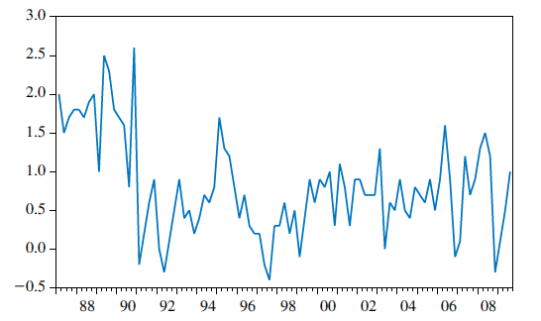
9.3
Serial Correlation
FIGURE 9.7 (a) Time series for Australian price inflation
9.3.2a
A Phillips Curve

Slide 42
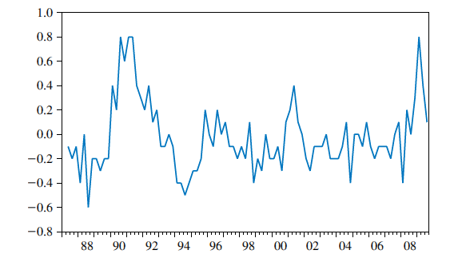
9.3
Serial Correlation
FIGURE 9.7 (b) Time series for the quarterly change in the Australian unemployment rate
9.3.2a
A Phillips Curve

Slide 43

9.3
Serial Correlation
9.3.2a
A Phillips Curve
To determine if the errors are serially correlated, we compute the least squares residuals:
Eq. 9.20
$${\hat{e}}_{t}=INF_{t}−b_{1}−b_{2}DU_{t}$$

Slide 44
9.3
Serial Correlation
FIGURE 9.8 Correlogram for residuals from least-squares estimated Phillips curve
9.3.2a
A Phillips Curve

Slide 45
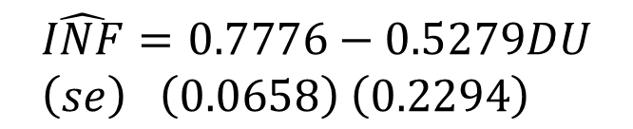
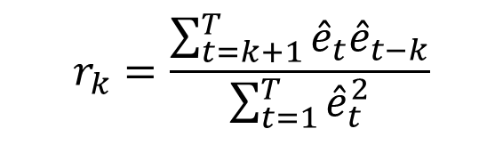
9.3
Serial Correlation
9.3.2a
A Phillips Curve
The k-th order autocorrelation for the residuals can be written as:
The least squares equation is:
$$r_{k}=\frac{\sum_{t=k+1}^{T}{{\hat{e}}_{t}{\hat{e}}_{t−k}}}{\sum_{t=1}^{T}{{\hat{e}}_{t}^{2}}}$$
Eq. 9.21
$$\hat{INF}=0.7776−0.5279DU \\ \left(se\right) \left(0.0658\right) \left(0.2294\right)$$
Eq. 9.22

Slide 46
9.3
Serial Correlation
9.3.2a
A Phillips Curve
The values at the first four lags are:
$$r_{1}=0.549 r_{2}=0.456 r_{3}=0.433 r_{4}=0.420$$

Slide 47
9.4
Other Tests for Serially Correlated Errors

Slide 48
9.4
Other Tests for Serially Correlated Errors
9.4.1
A Lagrange Multiplier Test
An advantage of this test is that it readily generalizes to a joint test of correlations at more than one lag

Slide 49

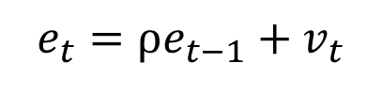
9.4
Other Tests for Serially Correlated Errors
9.4.1
A Lagrange Multiplier Test
If e_{t} and e_{t-1} are correlated, then one way to model the relationship between them is to write:
We can substitute this into a simple regression equation:
Eq. 9.23
$$e_{t}=ρe_{t−1}+v_{t}$$
Eq. 9.24
$$y_{t}=β_{1}+β_{2}x_{t}+ρe_{t−1}+v_{t}$$

Slide 50



9.4
Other Tests for Serially Correlated Errors
9.4.1
A Lagrange Multiplier Test
To derive the relevant auxiliary regression for the autocorrelation LM test, we write the test equation as:
But since we know that , we get:
$$y_{t}=β_{1}+β_{2}x_{t}+ρ{\hat{e}}_{t−1}+v_{t}$$
Eq. 9.25
$$y_{t}=b_{1}+b_{2}x_{t}+{\hat{e}}_{t}$$
$$b_{1}+b_{2}x_{t}+{\hat{e}}_{t}=β_{1}+β_{2}x_{t}+ρ{\hat{e}}_{t−1}+v_{t}$$

Slide 51
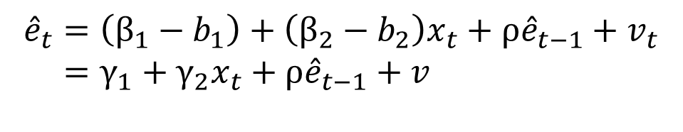
9.4
Other Tests for Serially Correlated Errors
9.4.1
A Lagrange Multiplier Test
Rearranging, we get:
If H₀: ρ = 0 is true, then LM = T x R² has an approximate χ²₍₁₎ distribution
T and R² are the sample size and goodness-of-fit statistic, respectively, from least squares estimation of Eq. 9.26
$${\hat{e}}_{t}=\left(β_{1}−b_{1}\right)+\left(β_{2}−b_{2}\right)x_{t}+ρ{\hat{e}}_{t−1}+v_{t} \\ =γ_{1}+γ_{2}x_{t}+ρ{\hat{e}}_{t−1}+v$$
Eq. 9.26

Slide 52

9.4
Other Tests for Serially Correlated Errors
9.4.1
A Lagrange Multiplier Test
Then:
These value is much larger than 3.84, which is the 5% critical value from a χ²₍₁₎-distribution
We reject the null hypothesis of no autocorrelation
Alternatively, we can reject H₀ by examining the p-value for LM = 27.61, which is 0.000
$${\hat{e}}_{0}$$
$$LM=T×R^{2}=90×0.3066=27.59$$

